Slide 1
How to :
Download, Read & Analyze
PQDIF Files from PMC-680i
10-Jun -2013 , Alan Hua

Slide 2
What is PQDIF?

Slide 3
PQDIF: Power Quality Data Interchange Format
Over the last several years, the Electric Power Research Institute (EPRI) and one of its contractors (Electrotek Concepts, Inc.) have been developing a vendor independent interchange format for power quality related information.
In 1996, EPRI and Electrotek placed PQDIF in the public domain to facilitate the interchange of power quality data between interested parties. EPRI and Electrotek have also offered the format, sample source code, and documentation to the IEEE 1159.3 task force as a possible initial format to meet that groups requirements.
Complete background information, documentation, and sample source code for PQDIF can be found at the following URL: http://grouper.ieee.org/groups/1159/3/docs.html
Since the materials available are quite extensive, instructions exist on this site to obtain a free CD-ROM containing all of the documentation, examples, and additional utility programs not found on the WWW site.
PQDIF is also being used as one of the standard formats for arbitrary waveform, spectrum, and power quality data in the Utility Communication Architecture (UCA) Generic Object Models for Substation and Feeder Equipment (GOMSFE). UCA is a 10+ year old EPRI initiative that was placed into the public domain several years ago and is now in the process of being turned over to the IEEE and published as an IEEE technical report. This work is being coordinated via IEEE Standards Coordinating Committee 36 chaired by Joe Koepfinger. Its permanent home will be in the IEC Technical Committee 57, working groups 10, 11 and 12 where it will be harmonized with related work. This harmonization has been underway for some time now. A new WWW site is available for more information on UCA: http://www.ucaforum.org/.
Notes:
IEEE 1159.3 PQDIF Draft 9 (Recirculated Ballot Document) could not download. Cause: The server grouper.ieee.org at P1159.3 working group area requires a username and password.
Unable to open http://www.ucaforum.org

Slide 4
In short, a PQDIF file contains the real-time RMS measurements, waveforms, phasors information from a single event. Thus, it is used as event analysis material by cross reference of these records.

Slide 5
The Capability of PMC-680i for PQDIF

Slide 6
The PMC-680i equips with 4GB/8GB of internal configurable memory to store measurements and records including the PQDIF files.
Depends on the frequency of occurrence of the event, the PMC-680i can store about 6 months of PQDIF files including the following data:
PQ Category | PQ Parameters | Phase | Duration
V rms | V ln | ABC+U4 | 150-CYCLE
V rms | Vll | AB+BC+CA | 150-CYCLE
I rms |  | ABC+I4+I5 | 150-CYCLE
V Harmonics | V THD,V TOHD,V TEHD,V fund, V 2nd－63rdHD | ABC+U4 | 150-CYCLE
I Harmonics | I THD,I TOHD,I TEHD,I fund, I 2nd－64rdHD | ABC+I4+I5 | 150-CYCLE
V unbalance | Positive, Negative, Zero Sequence & Unbalance |  | 150-CYCLE
I unbalance | Positive, Negative, Zero Sequence & Unbalance |  | 150-CYCLE
Flicker short term |  | ABC | 10-MIN
Flicker long term |  | ABC | 2-HOUR
Power total | P/Q/S | ABC+Total | 150-CYCLE
Power of Fundamental | P/Q/S | ABC+Total | 150-CYCLE
Power of Harmonics | P | ABC+Total | 150-CYCLE
Power Factor | PF/DF | ABC+Total | 150-CYCLE
Freq |  |  | 150-CYCLE
V deviation |  | ABC | 150-CYCLE

Slide 7
1. To Download the PQDIF Files from PMC-680i

Slide 8
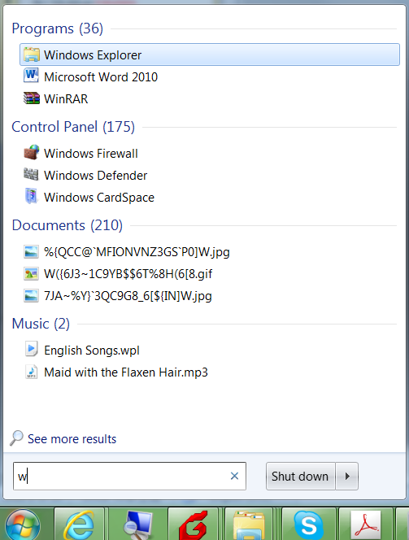
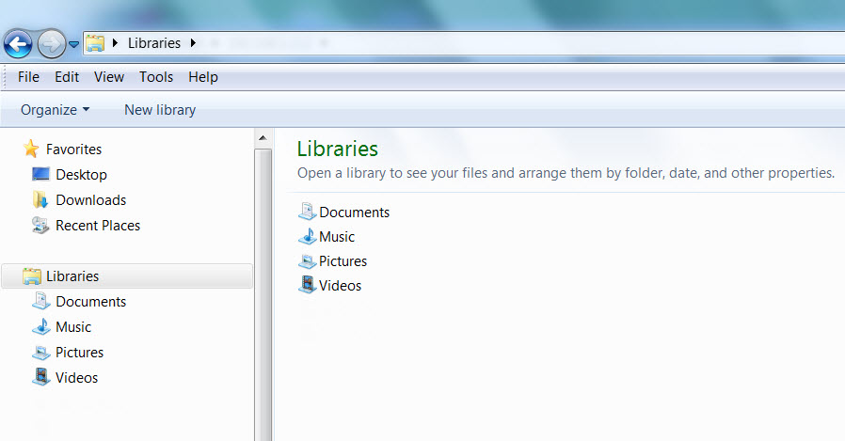
Step 1. Firstly, simply open Windows Explorer (Method 1) A. Click Start → Computer → Libraries B. Type w in the run box and select Windows Explorer from Programs

Slide 9
Step 1. Firstly, simply open the Internet Explorer (Method 2)

Slide 10
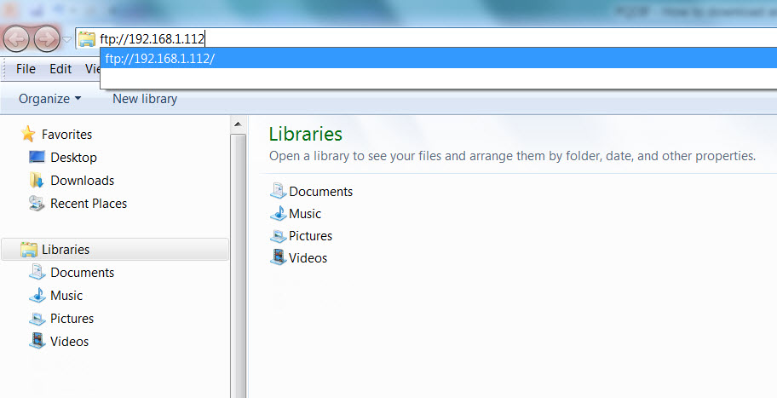
Step 2. Type in the FTP IP address of your PMC-680i as follows. For example: my PMC-680i has IP address of 192.168.1.112, so here I type ‘ftp://192.168.1.112’

Slide 11
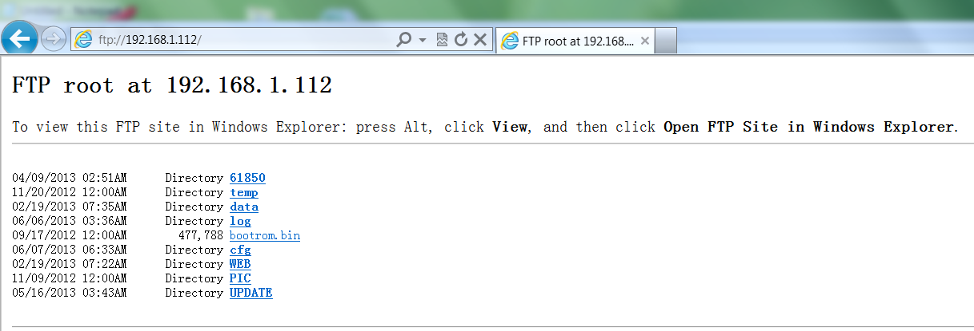
Step 2. Type in the FTP IP address of your PMC-680i as follows. For example: my PMC-680i has IP address of 192.168.1.112, so here I type ‘ftp://192.168.1.112’

Slide 12
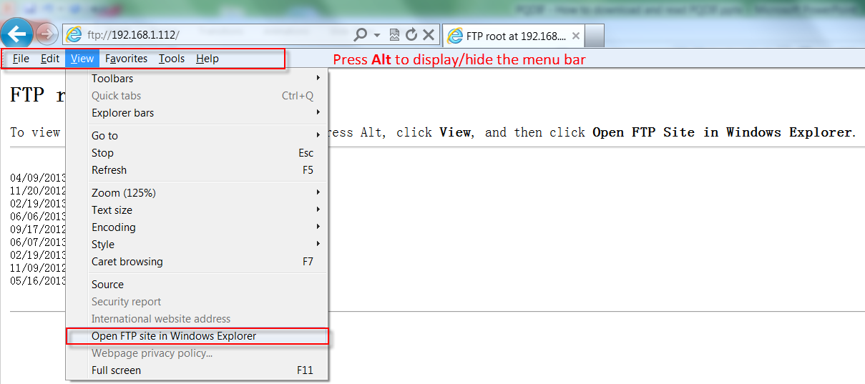
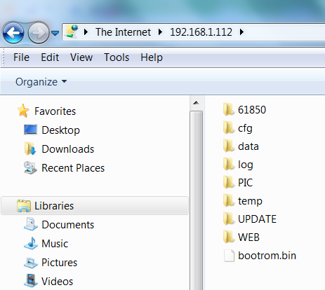
Step 2. Press Alt to display the menu bar, select View → Open FTP site in Windows Explorer

Slide 13
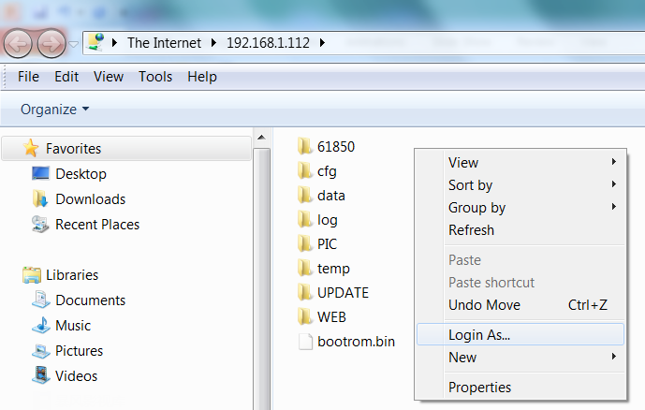
Step 3. On the blank area of the right pan, right click the mouse and select ‘Login As…’

Slide 14
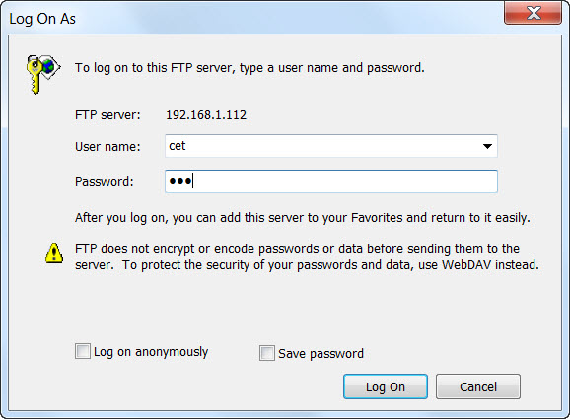
Step 4. Login with account name ‘cet’ and password ‘680’.

Slide 15
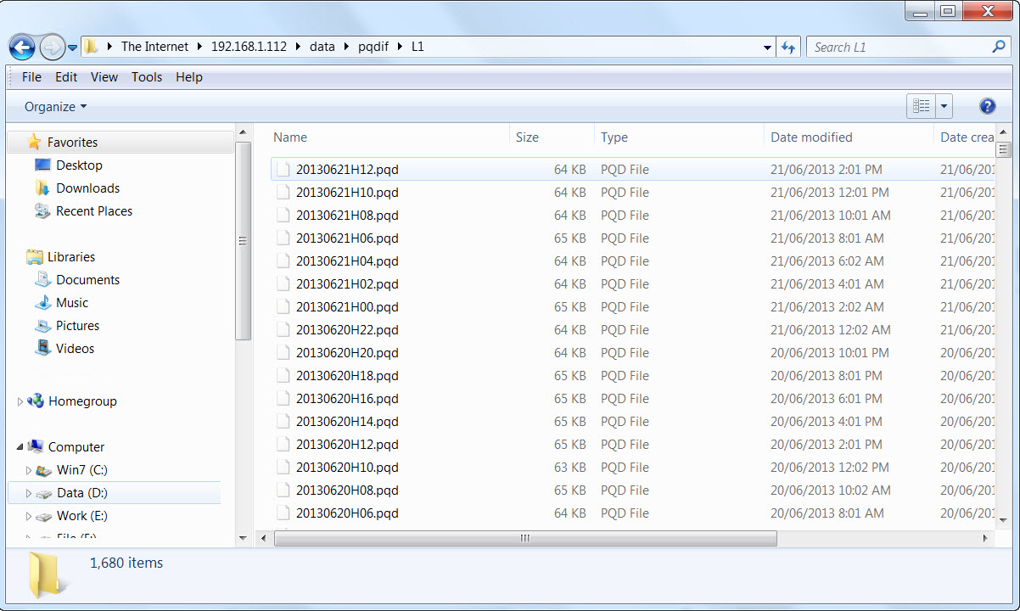
Step 5. Go to sub-folder ‘data/PQDIF’, and make copy of these .pqd files to the destination folder you want

Slide 16
2. To Read the PQDIF Files from PMC-680i

Slide 17
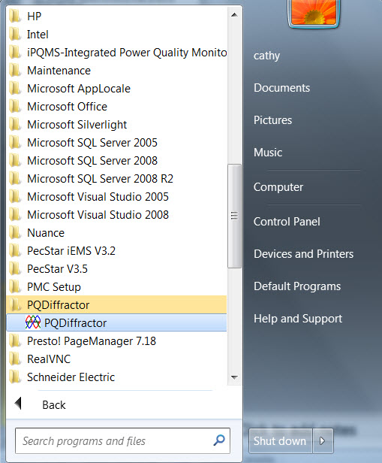
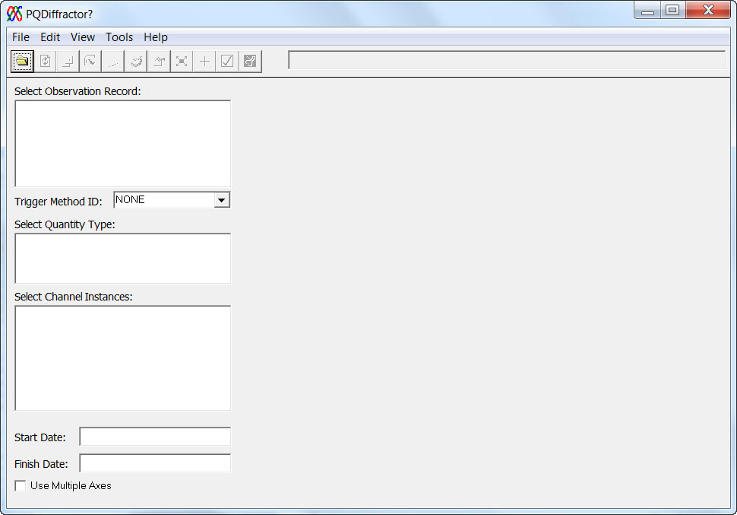
Step 1. Install the ‘PQDiffractor.exe’ in advance. Start up this program.

Slide 18
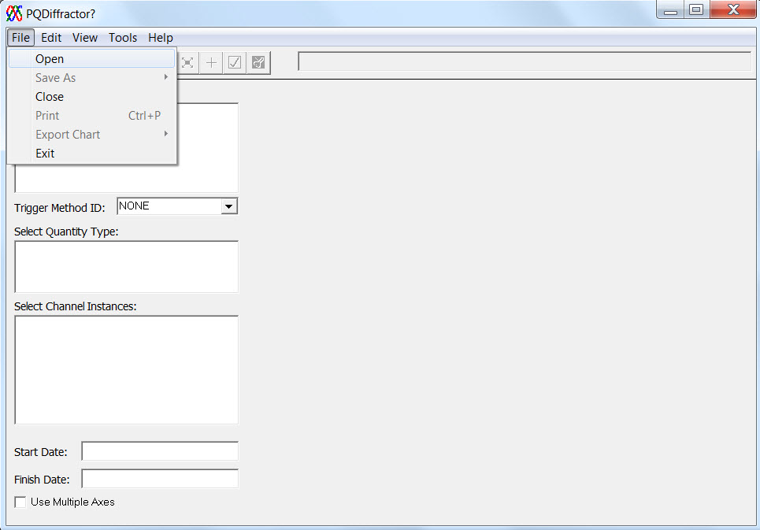
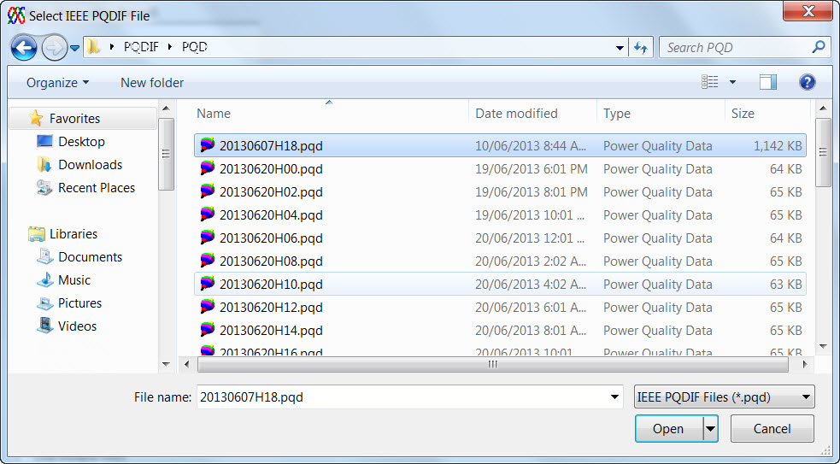
Step 2. Select ‘File → Open’ then select the PQDIF file you previously saved.

Slide 19
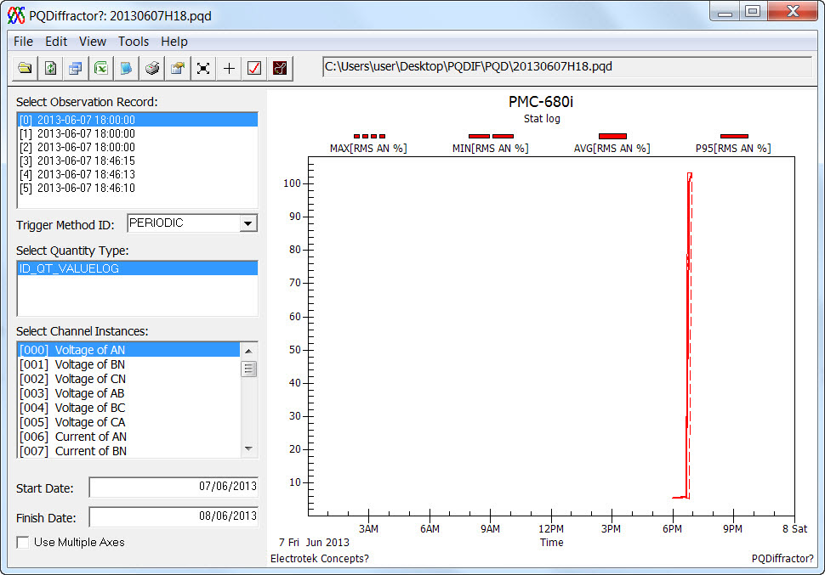
Step 3. Select the record you want to observe from the left pan.
Part 1: Real-time logs

Slide 20
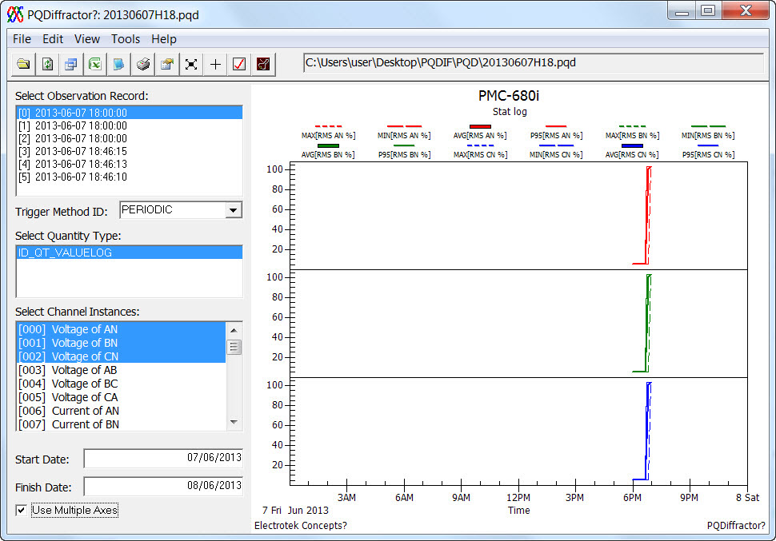
Part 1: Real-time logs → ‘Use Multiple Axes’
How to explain the timing relationship in the trend charts and waveform??

Slide 21
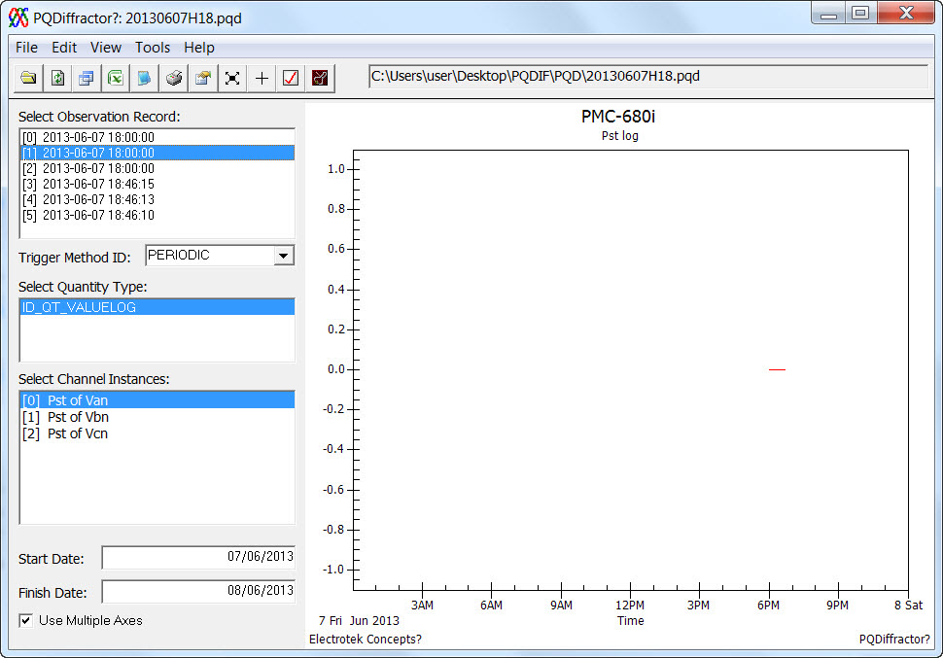
Part 2: Real-time logs(Flicker Pst)

Slide 22
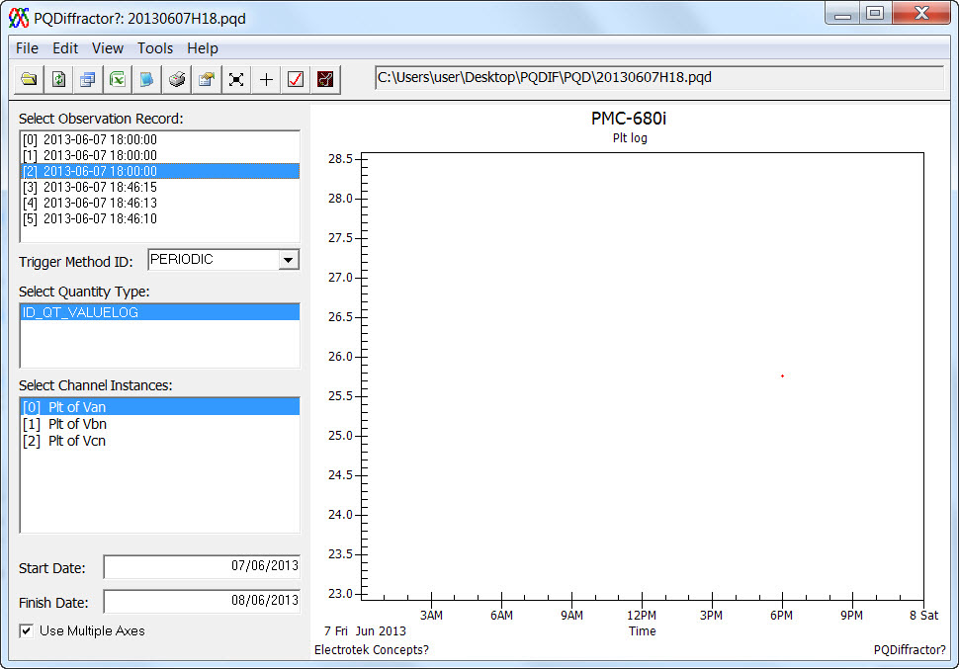
Part 3: Real-time logs(Flicker Plt)

Slide 23
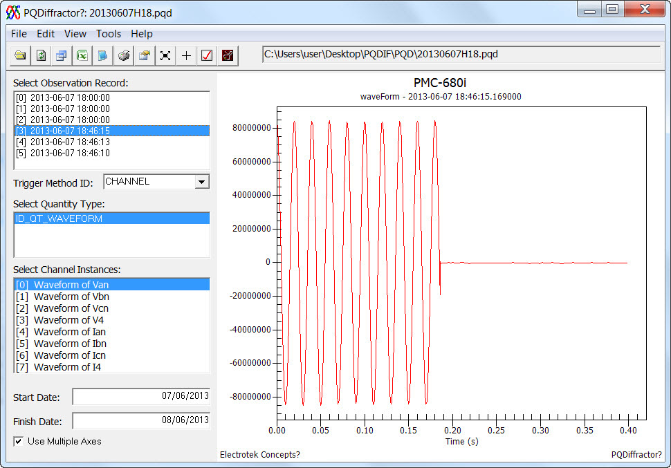
Part 4: Group#1 Waveform(higher resolution but shorter duration)
Zoom in:
Drag the mouse to select a region from top to bottom

Slide 24
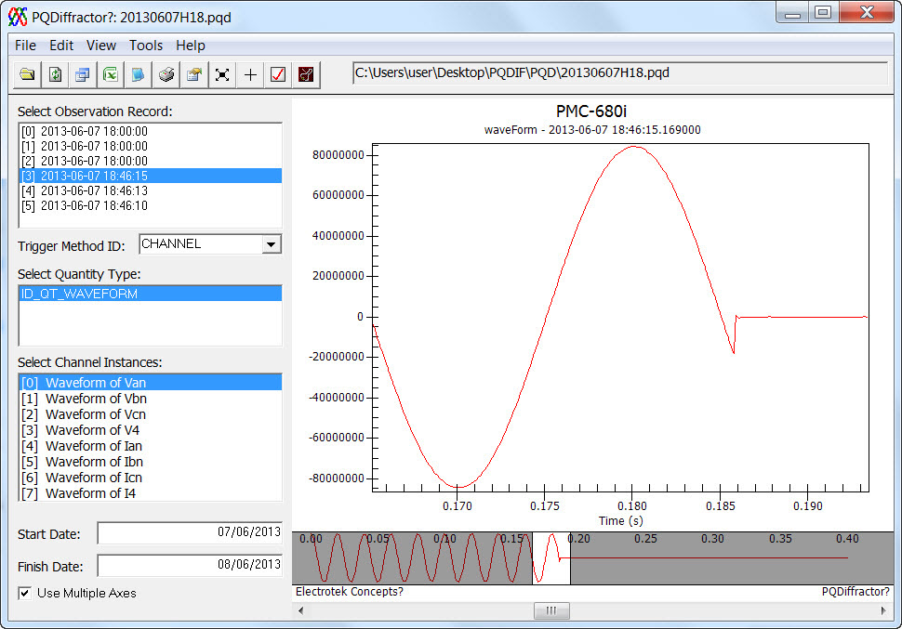
Part 4: Group#1 Waveform→ Zoom in
Move this bar to move the waveform forward or backward.

Slide 25
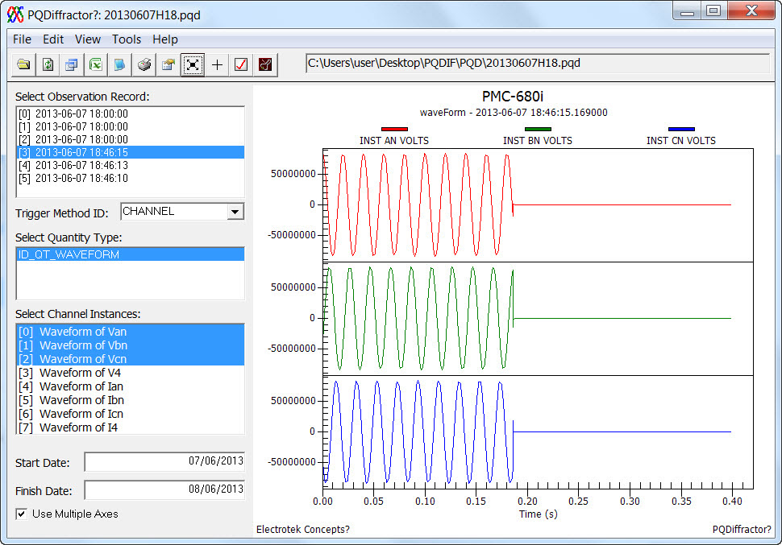
Part 4: Group#1 Waveform→ Use Multiple Axes with Van,Vbn,Vcn at same time

Slide 26
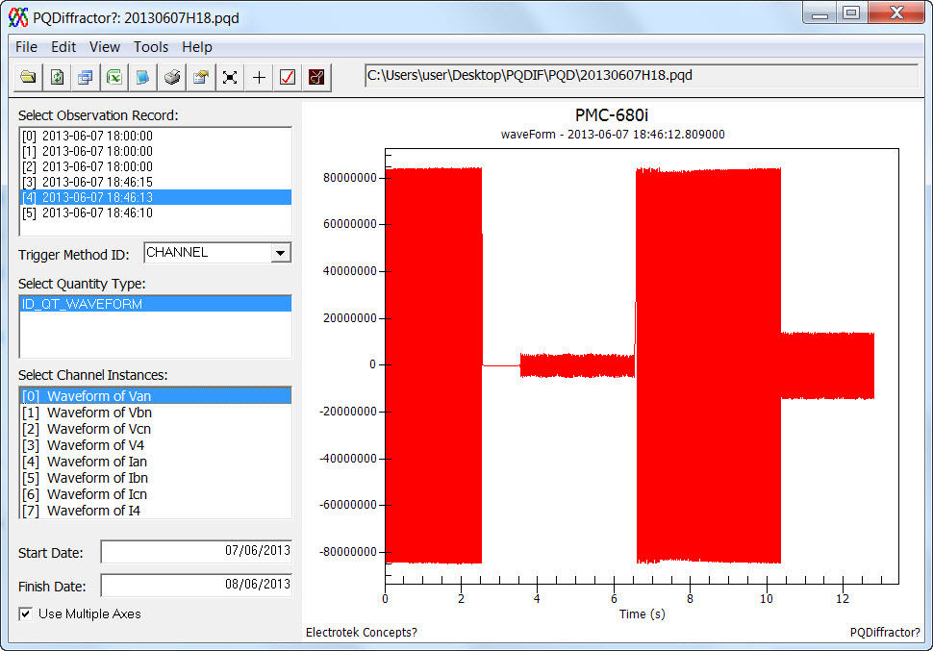
Part 5: Group#2 Waveform(lower resolution but extended duration)

Slide 27
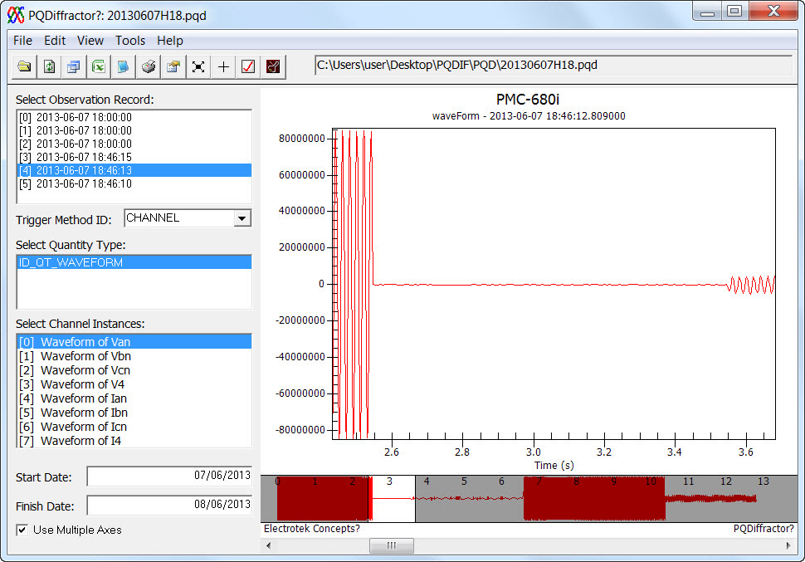
Part 5: Group#2 Waveform→ Zoom in
Move this bar to move the waveform forward or backward.

Slide 28
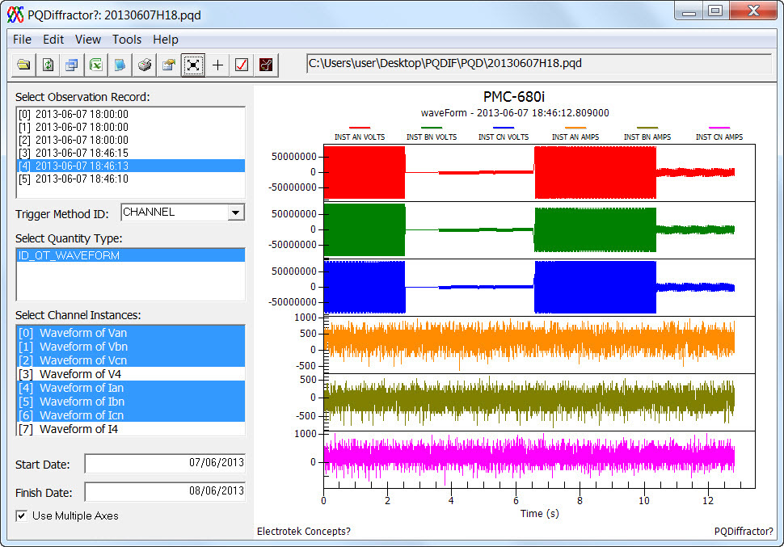
Part 5: Group#1 Waveform→ Use Multiple Axes with Van,Vbn,Vcn Ia,Ib,Ic at same time

Slide 29
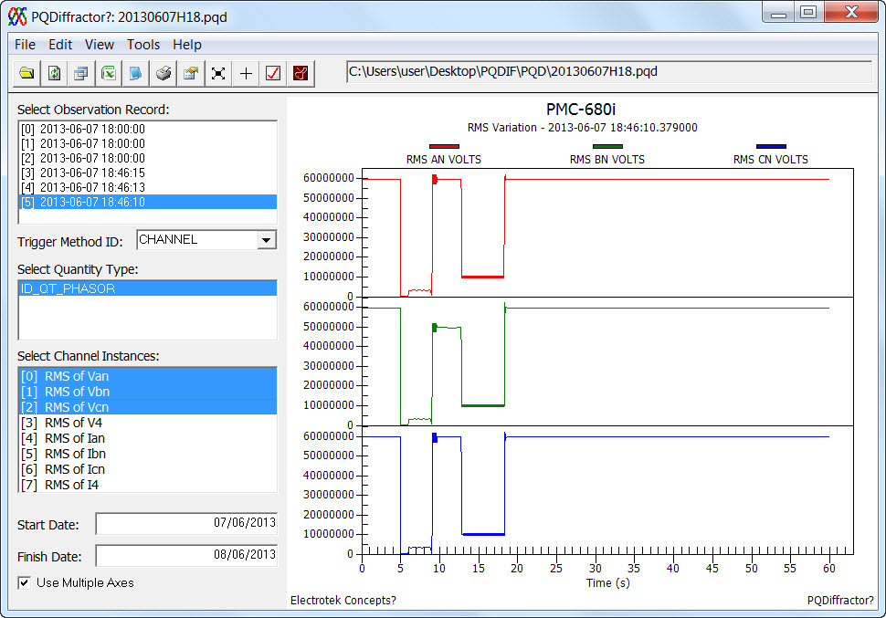
Part 6: RMS Variation

Slide 30
if the design of the PQDIF file structure is appropriate and useful and can even win over our competitors???

